Slide 1
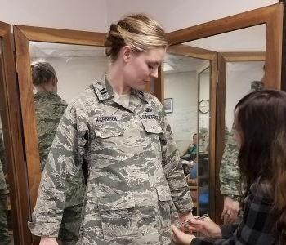
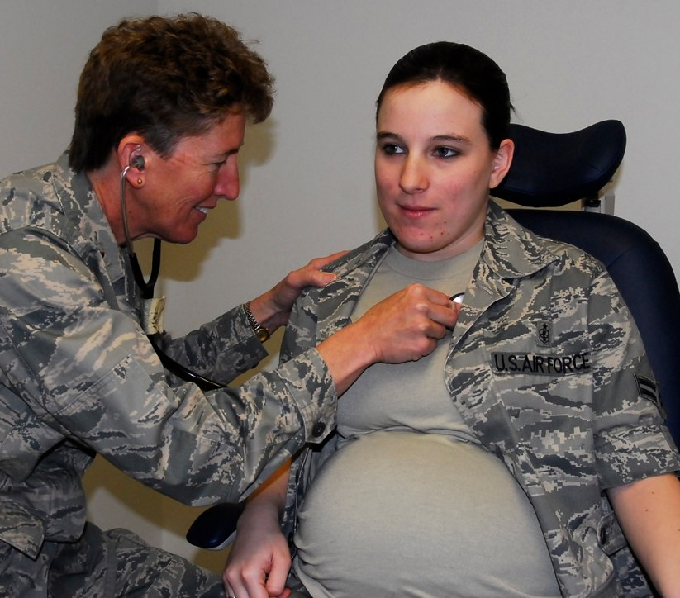
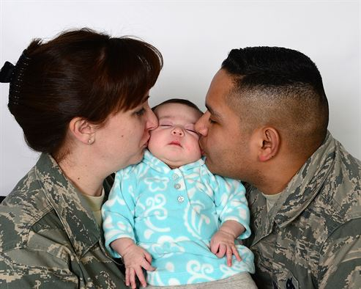

Welcome to
Air Force Financial Readiness:
Babies and Budgets
Personal Financial Readiness

Slide 2


Agenda
Baby Inbound
Baby Onboard
Baby Upward Bound

Slide 3
Disclaimer
The information provided in this training does not constitute a formal endorsement of any company, its products, or services by the Air Force. Specifically, the appearance or use of external hyperlinks does not constitute endorsement by the Air Force of the linked websites, or the information, products, or services contained therein. The Air Force does not exercise any editorial control over the information they may find at these locations. This information provides informational resource material to assist military personnel and their families and to assist in identifying or exploring resources and options.

Slide 4

Growing Family Feud!
Points | Expense | Estimated First-Year Expenditure
5 | Child care | $10,000
4 | Unpaid parental leave | $7,000
3 | Formula | $1,560
2 | Baby gear | $1,350
1 | Diapers and wipes | $1,000
Notes:
Animation – 1 click

Slide 5
Financial Readiness for New Child Expenses
Reduce Debt
Limit Anticipatory Spending
Adjust Student Loans
Practice “Baby Normal”
Baby Inbound
Notes:
Animation – 4 clicks

Slide 6


Reduce Debt
Money spent on debt service cannot be used for current expenses.
Your A&FRC offers personal financial counseling and education.
Notes:
Animation – 2 clicks

Slide 7

Adjust Student Loans
Investigate income-driven repayment plans.
Check availability of the Public Service Loan Forgiveness program.
Different loans offer different terms.
Use estimator tool for income scenarios.
Always work through your loan servicer.
https://studentaid.gov/manage-loans/repayment/plans
Notes:
Animation – 6 clicks

Slide 8


Limit Anticipatory Spending
Unless child safety is at stake, delay these major purchases.
Notes:
Animation – 1 click

Slide 9

Practice “Baby Normal”
Adjusting to major financial changes takes at least three months.
Test drive a new spending plan as if baby has arrived and adjust as needed.
Surpluses can be used to reduce debt, save, or invest.
Notes:
Animation – 3 clicks

Slide 10
Summary and Questions
Reduce Debt.
Limit Anticipatory Spending.
Adjust Student Loans.
Practice “Baby Normal.”
Notes:
Animation – 4 clicks

Slide 11
Money-Saving Strategies for New Parents
Register for Baby Needs
Take Advantage of Freebies
Look for Gently Used Bargains
Use Your Military Resources
Baby Onboard
Notes:
Animation – 4 clicks

Slide 12


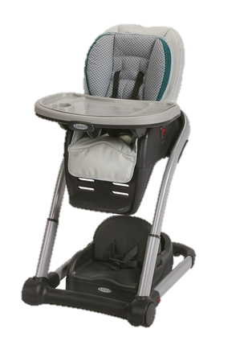

The Price is High!
Notes:
DaVinci Piedmont 4-in-1 Crib and Sealy Posturepedic Mattress: $249+$110 = $359.00
Chicco Bravo LE TrioTravel System (stroller and infant carrier car seat): $419.99
Graco Blossom 4-in-I Highchair Seating System: $139.00
Owlet Digital Color Video Baby Monitor: $149.99
Total cost of all items: $1,107.98

Slide 13

Register for Baby’s Needs

Slide 14
Take Advantage of Freebies
Seek out promotional giveaways.
Take the Bundles for Babies course at the Air Force Aid Society.
Look in local “shopper” papers.
Search online classifieds.
Look for postings in neighborhood groups.
Ask family members and friends.
Be sure that older items are still safe to use.
Notes:
Animation – 7 clicks

Slide 15

Look for Gently Used Bargains
Airmen’s Attic
Private sales
Garage/tag/yard sales
Thrift stores
Be sure that older items are still safe to use.
Notes:
Animation – 1 click

Slide 16

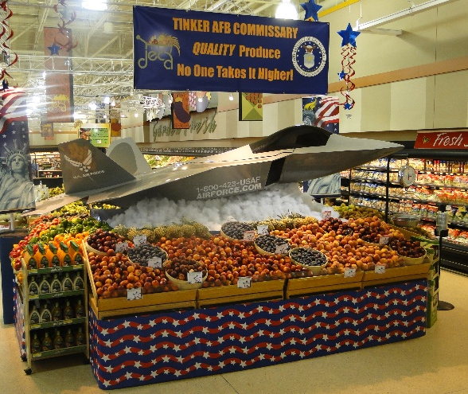
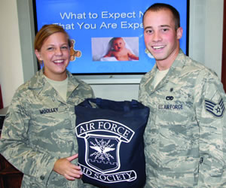
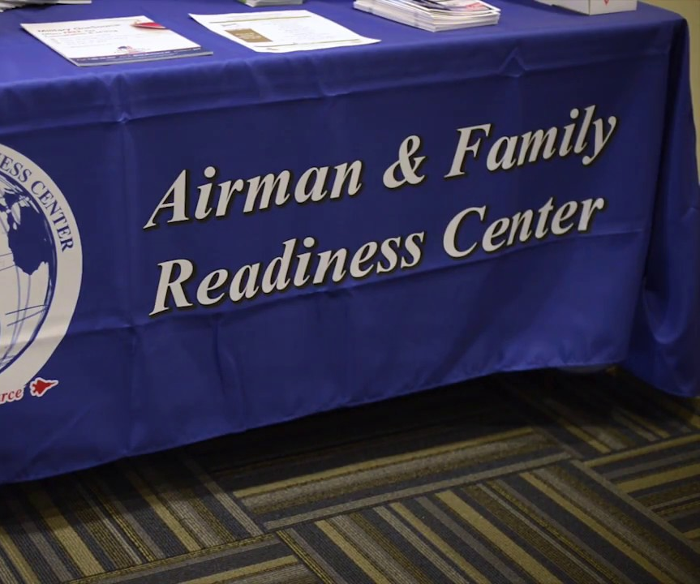
Use Your Military Resources
Exchange
Commissary
Air Force Aid Society
Airman and Family Readiness Center (or other military family support center)

Slide 17
Summary and Questions
Register for Baby Needs.
Take Advantage of Freebies.
Look for Gently Used Bargains.
Use Your military Resources.
Notes:
Animation – 4 clicks

Slide 18
Financial Planning for the First Year and Beyond
Review Insurance
Maintain or Increase Savings
Invest for College
Invest for Retirement
Baby Upward
Bound
Notes:
Animation – 4 clicks

Slide 19

Protecting Yourself and Your
Family’s Financial Interests
Insurance transfers risk.
Life events affect insurance needs.
For Airmen, health and disability insurance are funded by the U.S. government.
Life insurance (SGLI) is inexpensive but may be insufficient.

Slide 20
Review Insurance - Life
$ 40,764
22
Income Replacement: ____________ x ___ years =
+ Final Expenses
+ Readjustment Expenses __________ x ___ years =
+ Children’s College _______________ x ___ years =
Existing Death Benefits (SGLI + Death Gratuity) ( )
= Additional Life Insurance Needed
$ 896,808
10,000
$ 40,000
0.5
20,000
$ 10,000
4
40,000
500,000
*
$ 466,808
*
* Death benefits may also include Dependency and Indemnity Compensation (currently $1319.04/month for surviving spouses who do not remarry before age 57) and $326.77/month for each surviving child under age 18.
Notes:
Animation – 1 click

Slide 21

Review Insurance - Property
Policies should cover property and liability.
Insure property at replacement value rather than “actual cash value.”
Increase liability insurance for visiting children.
Consider an “umbrella policy.”
Notes:
Animation – 4 clicks

Slide 22

Maintain or Increase Savings
Start now!
Contribute regularly.
Build an emergency reserve equal to three-six months of household income.

Slide 23

Invest for College
Saving: Safe, but low interest
Investing: Start early; take advantage of compound earnings.
Options:
  529 Plans
  Coverdell Education Savings Accounts
  Trusts under the Uniform Gifts to Minors (UGMA) and Uniform Transfer to minors (UTMA) Acts
Shop for strong track record, low management costs.
Also consider transferring Post-9/11 GI Bill benefits.
Notes:
Animation – 8 clicks

Slide 24

Invest for Retirement
Keep participating in TSP.
Contribute at least 5% to receive all matching funds for BRS members.
Contribute more (up to $19,500 in 2021) if possible.
Other investments: IRAs, stocks, bonds, mutual funds.
Notes:
Animation – 4 clicks

Slide 25

Alphabet Sprint

Slide 26
Summary and Questions
Review Insurance.
Maintain or Increase Savings.
Invest for College.
Invest for Retirement.
Notes:
Animation – 4 clicks

Slide 27

Conclusion
Evaluations and Certificates
Thank you!

